Slide 1

HR DATA ANAYSIS USING EXCEL AND POWER BI
INTERNSHIP TASK 1
Prepared By –Rakhi Ghulaxe

Slide 2
AGENDA
Data Exploration
Data Questions
Data Insights
Dashboards

Slide 3
DATA EXPLORATION
The Data is located across multiple Excel Files.
The Data consist of 4410 records over 24 attributes in tabular form.
The Data is information about employees in a sales company.
By exploring our Data, it appears to be clean and ready to go.

Slide 4
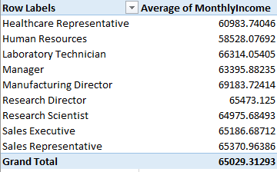
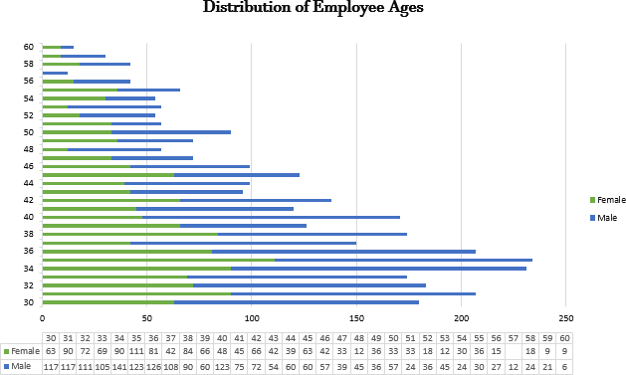
Using Excel, how would you filter the dataset to only show employees aged 30 and above?
Answer: Data ripen Filter OR Ctrl + A Then Ctrl + T Insert ripen Pivot Table
Create a pivot table to summarize the average Monthly Income by Job Role.
Answer
Apply conditional formatting to highlight employees with Monthly Income above the company's average income.
Answer: Conditional Formatting Top/Bottom Rules Above Average
Create a bar chart in Excel to visualize the distribution of employee ages. Answer:

Slide 5
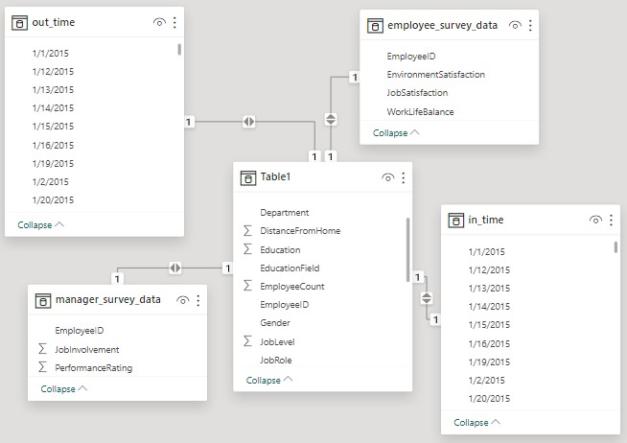
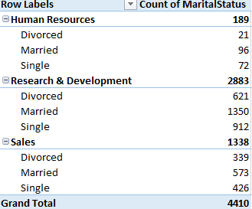
Identify and clean any missing or inconsistent data in the "Department" column.
Answer: Remove Duplicate + Go to special (Blanks)
There is no missing data in the "Department" column, then we go to find&replace and replace Sales with Sales Department
In Power BI, establish a relationship between the "Employee ID" in the employee data and the "Employee ID" in the time tracking data.
Answer:
7. Using Excel, create a pivot table that displays the count of employees in each Marital Status category, segmented by Department.
Answer:

Slide 6
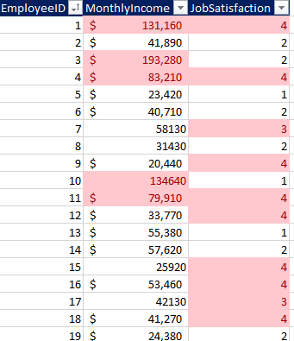
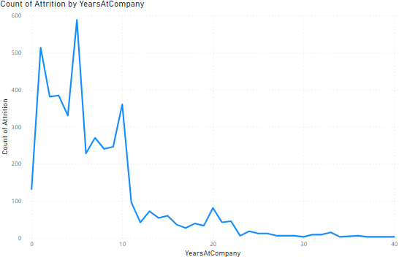
8. Apply conditional formatting to highlight employees with both above-average Monthly Income and above- average Job Satisfaction
Answer:
9. In Power BI, create a line chart that visualizes the trend of Employee Attrition over the years.
Answer:

Slide 7

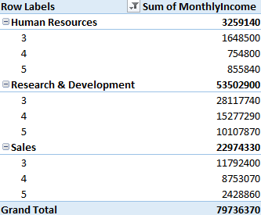
Describe how you would create a star schema for this dataset, explaining the benefits of doing so.
Answer: The Benefits of Star Schema
Star schema are efficient for storing data and updating data by reducing the duplication.
It is extremely simple to understand and build.
No need for complex joins when querying data.
Create a hierarchy in Power BI that allows users to drill down from Department to Job Role to further narrow their analysis.
Answer:
How can you set up parameterized queries in Power BI to allow users to filter data based 2 of 2 on the Distance from Home column?
Answer:
Select Home > Transform data > Transform data to open the Power Query Editor.
In the Power Query Editor, select New Parameters under Manage Parameters in the ribbon.
In the Manage Parameters window, fill out the information about the parameter.
In Excel, calculate the total Monthly Income for each Department, considering only the employees with a Job Level greater than or equal to 3.
Answer:

Slide 8
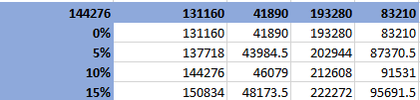
Explain how to perform a What-If analysis in Excel to understand the impact of a 10% increase in Percent Salary Hike on Monthly Income.
Answer:
Go to the "Data" tab.
In the "Data Tools" group, click "What-If Analysis" and choose "Data Table."
In "Row input cell," enter the reference to the cell with Percent Salary Hike.
Cliclk ok.
Verify if the data adheres to a predefined schema. What actions would you take if you find inconsistencies?
Answer:
Checking for the Data Types
Check for constraints such as unique constraints, primary keys,and foreign keys
Handling Missing Values
Addressing Duplicates Values in the data set

Slide 9
Dashboards

Slide 10
